Slide 1
An introduction to Wavelet Transform
Pao-Yen Lin
Digital Image and Signal Processing Lab
Graduate Institute of Communication Engineering
National Taiwan University

Slide 2
Outlines
Introduction
Background
Time-frequency analysis
Windowed Fourier Transform
Wavelet Transform
Applications of Wavelet Transform

Slide 3
Introduction
Why Wavelet Transform?
Ans: Analysis signals which is a function of time and frequency
Examples
Scores, images, economical data, etc.

Slide 4
Introduction
Conventional Fourier Transform
V.S.
Wavelet Transform

Slide 5
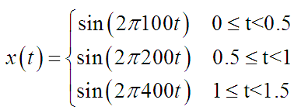
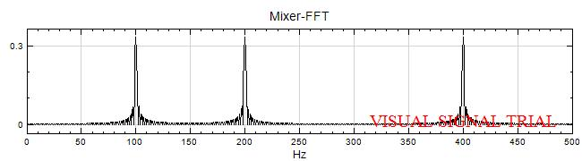
Conventional Fourier Transform
X( f )

Slide 6
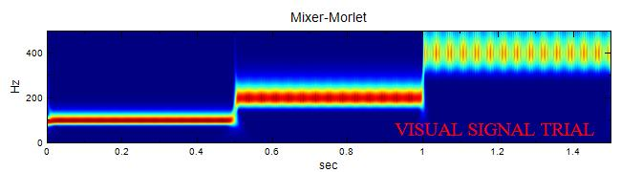
Wavelet Transform
W{x(t)}

Slide 7
Background
Image pyramids
Subband coding

Slide 8
Image pyramids
Fig. 1 a J-level image pyramid[1]

Slide 9
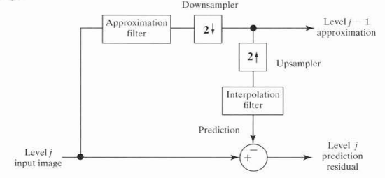
Image pyramids
Fig. 2 Block diagram for creating image pyramids[1]

Slide 10
Subband coding
Fig. 3 Two-band filter bank for one-dimensional subband coding and decoding system and the corresponding spectrum of the two bandpass filters[1]

Slide 11
Subband coding
Conditions of the filters for error-free reconstruction
For FIR filter

Slide 12
Time-frequency analysis
Fourier Transform
Time-Frequency Transform
time-frequency atoms

Slide 13
Heisenberg Boxes
is represented in a time-frequency plane by a region whose location and width depends on the time-frequency spread of .
Center?
Spread?

Slide 14
Heisenberg Boxes
Recall that ,that is:
Interpret as a PDF
Center : Mean
Spread : Variance

Slide 15
Heisenberg Boxes
Center (Mean) in time domain
Spread (Variance) in time domain

Slide 16
Heisenberg Boxes
Plancherel formula
Center (Mean) in frequency domain
Spread (Variance) in frequency domain

Slide 17
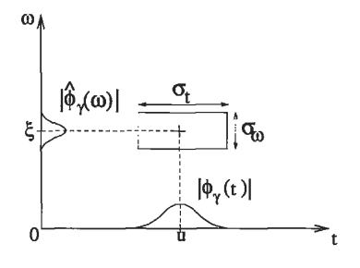
Heisenberg Boxes
Heisenberg uncertainty
Fig. 4 Heisenberg box representing an atom [1].

Slide 18
Windowed Fourier Transform
Window function
Real
Symmetric
For a window function
It is translated by μ and modulated by the frequency
is normalized

Slide 19
Windowed Fourier Transform
Windowed Fourier Transform (WFT) is defined as
Also called Short time Fourier Transform (STFT)
Heisenberg box?

Slide 20
Heisenberg box of WFT
Center (Mean) in time domain
is real and symmetric, is centered at zero
is centered at in time domain
Spread (Variance) in time domain
independent of and

Slide 21
Heisenberg box of WFT
Center (Mean) in frequency domain
Similarly, is centered at in time domain
Spread (Variance) in frequency domain
By Parseval theorem:
Both of them are independent of and .

Slide 22
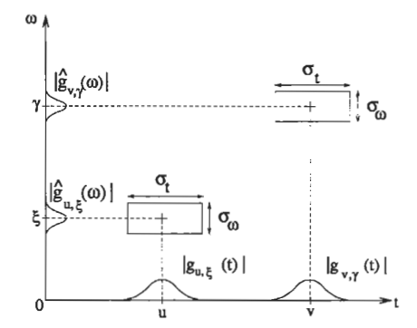
Heisenberg box of WFT
Fig. 5 Heisenberg boxes of two windowed Fourier atoms and [1]

Slide 23
Wavelet Transform
Classification
Continuous Wavelet Transform (CWT)
Discrete Wavelet Transform (DWT)
Fast Wavelet Transform (FWT)

Slide 24
Continuous Wavelet Transform
Wavelet function
Define
Zero mean:
Normalized:
Scaling by and translating it by :

Slide 25
Continuous Wavelet Transform
Continuous Wavelet Transform (CWT) is defined as
Define
It can be proved that
which is called Wavelet admissibility condition

Slide 26
Continuous Wavelet Transform
For
where
Zero mean

Slide 27
Continuous Wavelet Transform
Inverse Continuous Wavelet Transform (ICWT)

Slide 28
Continuous Wavelet Transform
Recall the Continuous Wavelet Transform
When is known for , to recover function we need a complement of information corresponding to for .

Slide 29
Continuous Wavelet Transform
Scaling function
Define that the scaling function is an aggregation of wavelets at scales larger than 1.
Define
Low pass filter

Slide 30
Continuous Wavelet Transform
A function can therefore decompose into a low-frequency approximation and a high-frequency detail
Low-frequency approximation of at scale :

Slide 31
Continuous Wavelet Transform
The Inverse Continuous Wavelet Transform can be rewritten as:

Slide 32
Heisenberg box of Wavelet atoms
Recall the Continuous Wavelet Transform
The time-frequency resolution depends on the time-frequency spread of the wavelet atoms .

Slide 33
Heisenberg box of Wavelet atoms
Center in time domain
Suppose that is centered at zero,
which implies that is centered at .
Spread in time domain

Slide 34
Heisenberg box of Wavelet atoms
Center in frequency domain
for , it is centered at
and

Slide 35
Heisenberg box of Wavelet atoms
Spread in frequency domain
Similarly,

Slide 36
Heisenberg box of Wavelet atoms
Center in time domain:
Spread in time domain:
Center in frequency domain:
Spread in frequency domain:
Note that they are function of ,
but the multiplication of spread remains the same.

Slide 37
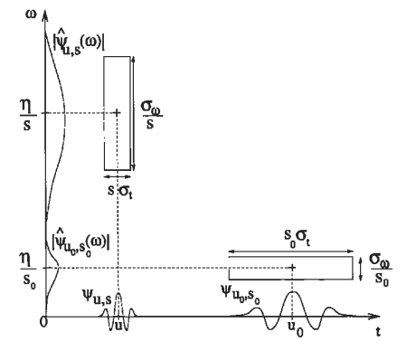
Heisenberg box of Wavelet atoms
Fig. 6 Heisenberg boxes of two wavelets. Smaller scales decrease the
time spread but increase the frequency support and vice versa.[1]

Slide 38
Examples of continuous wavelet
Mexican hat wavelet
Morlet wavelet
Shannon wavelet

Slide 39
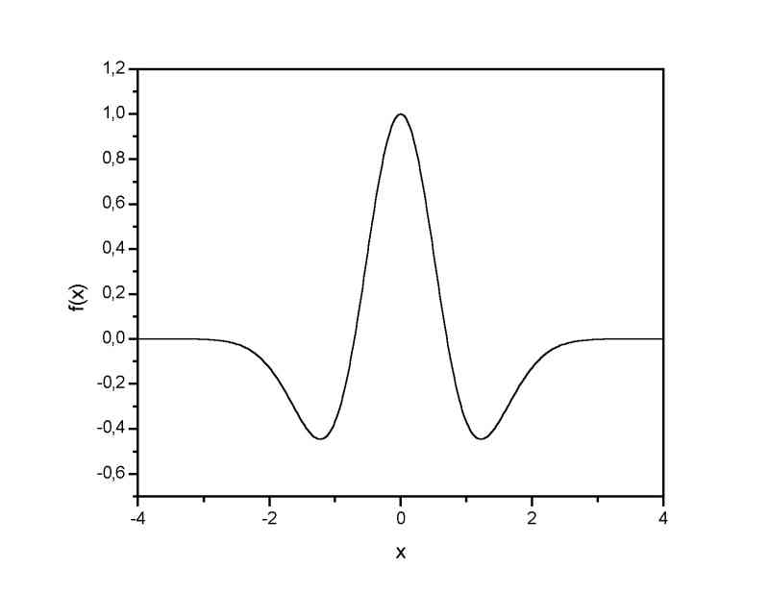
Mexican hat wavelet
Also called the second derivative of the Gaussian function
Fig. 7 The Mexican hat wavelet[5]

Slide 40
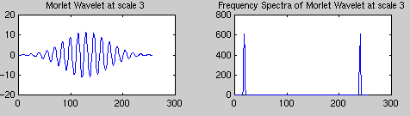
Morlet wavelet
U(ω): step function
Fig. 8 Morlet wavelet with m equals to 3[4]

Slide 41
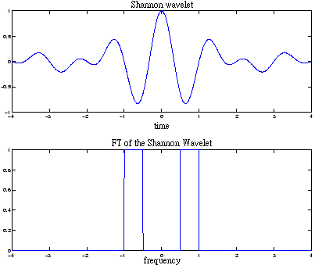
Shannon wavelet
Fig. 9 The Shannon wavelet in time and frequency domains[5]

Slide 42
Discrete Wavelet Transform (DWT)
Let
Usually we choose
discrete wavelet set:
discrete scaling set:

Slide 43
Discrete Wavelet Transform
Define
can be increased by increasing .
There are four fundamental requirements of multiresolution analysis (MRA) that scaling function and wavelet function must follow.

Slide 44
Discrete Wavelet Transform
MRA(1/2)
The scaling function is orthogonal to its integer translates.
The subspaces spanned by the scaling function at low resolutions are contained within those spanned at higher resolutions:
The only function that is common to all is . That is

Slide 45
Discrete Wavelet Transform
MRA(2/2)
Any function can be represented with arbitrary precision. As the level of the expansion function approaches infinity, the expansion function space V contains all the subspaces.

Slide 46
Discrete Wavelet Transform
subspace can be expressed as a weighted sum of the expansion functions of subspace .
scaling function coefficients

Slide 47
Discrete Wavelet Transform
Similarly,
Define
The discrete wavelet set spans the difference between any two adjacent scaling subspaces, and
.

Slide 48
Discrete Wavelet Transform
Fig. 10 the relationship between scaling and wavelet function space[1]

Slide 49
Discrete Wavelet Transform
Any wavelet function can be expressed as a weighted sum of shifted, double-resolution scaling functions
wavelet function coefficients

Slide 50
Discrete Wavelet Transform
By applying the principle of series expansion, the DWT coefficients of are defined as:
Arbitrary scale
Normalizing factor

Slide 51
Discrete Wavelet Transform
can be expressed as:

Slide 52
Fast Wavelet Transform (FWT)
Consider the multiresolution refinement equation
By a scaling of by , translation of by units:

Slide 53
Fast Wavelet Transform
Similarly,
Now consider the DWT coefficient functions

Slide 54
Fast Wavelet Transform
Rearranging the terms:

Slide 55
Fast Wavelet Transform
Thus, we can write:
Similarly,

Slide 56
Fast Wavelet Transform
Fig. 11 the FWT analysis filter bank[1]

Slide 57
Fast Wavelet Transform
Fig. 12 the IFWT synthesis filter bank[1]

Slide 58
2-D DWT
Two-dimensional scaling function
Two-dimensional wavelet functions

Slide 59
2-D DWT
: variations along columns
: variations along rows
: variations along diagonals

Slide 60
2-D DWT
Basis

Slide 61
2-D DWT
The discrete wavelet transform of function of size :

Slide 62
2-D DWT
Two-dimensional IDWT

Slide 63
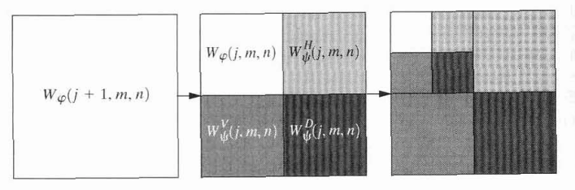
2-D DWT
Fig. 13 the resulting decomposition of 2-D DWT[1]

Slide 64
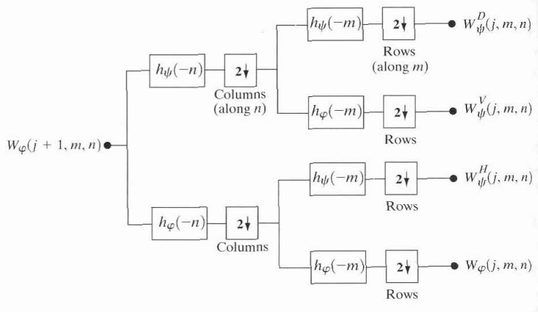
2-D FWT
Fig. 14 the two-dimensional FWT analysis filter bank[1]

Slide 65
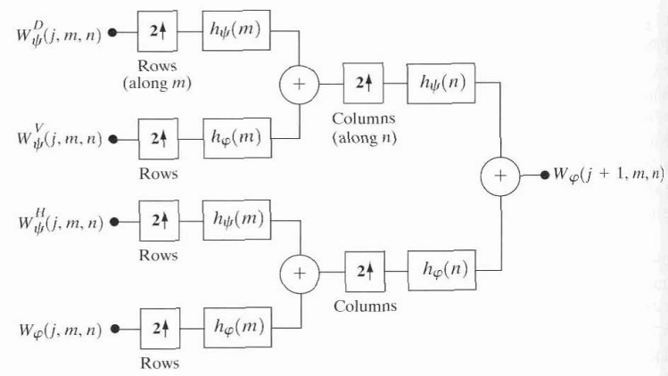
2-D FWT
Fig. 15 the two-dimensional IFWT synthesis filter bank[1]

Slide 66
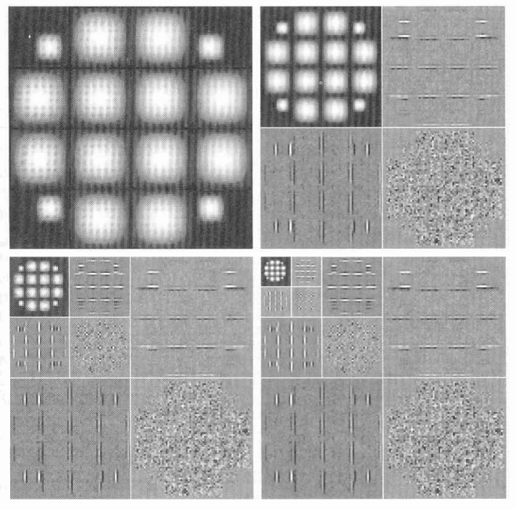
2-D DWT
Fig. 16 A three-scale FWT[1]

Slide 67
Comparison
Resolution
Complexity
Given function

Slide 68
Comparison of resolution
Fourier Transform
Fig. 17 the result using Fourier Transform

Slide 69
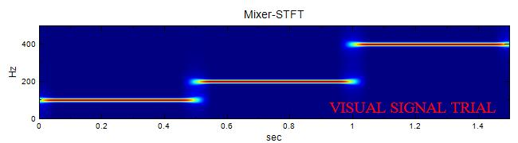
Comparison of resolution
Windowed Fourier Transform
Fig. 18 the result using Windowed Fourier Transform

Slide 70
Comparison of resolution
Discrete Wavelet Transform
Fig. 19 the result using Discrete Wavelet Transform

Slide 71
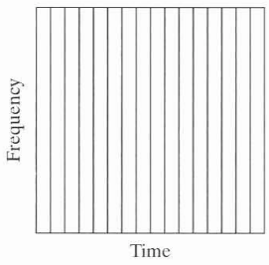
Comparison of resolution
Fig. 20 Time-frequency tilings for Fourier Transform[1]

Slide 72
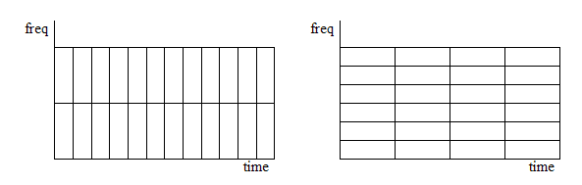
Comparison of resolution
Fig. 21 Time-frequency tilings for Windowed Fourier Transform with different window size[1]

Slide 73

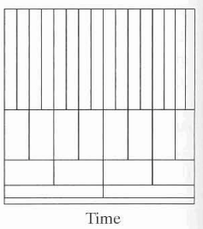
Comparison of resolution
Fig. 22 Time-frequency tilings for Wavelet Transform[1]

Slide 74
Comparison of complexity
 | FFT | WFT | FWT
Complexity
Table. 1 Comparison of complexity between FFT, WFT and FWT

Slide 75
Applications of Wavelet Transform
Image compression
Edge detection
Noise removal
Pattern recognition
Fingerprint verification
Etc.

Slide 76
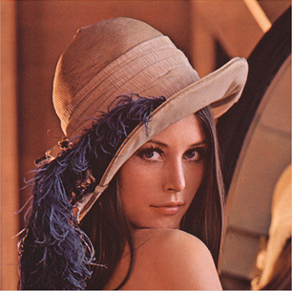
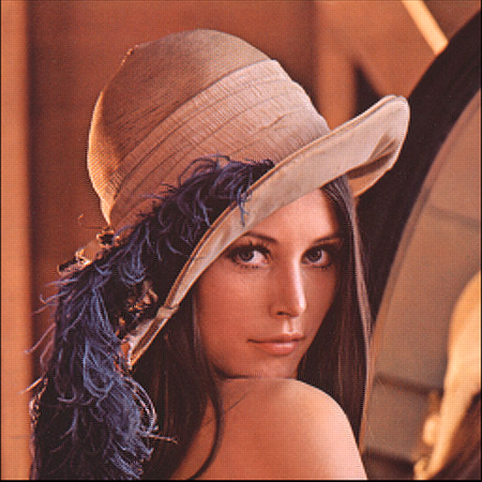
Applications of Wavelet Transform
Image compression
Fig. 23 Input image
Fig. 24 Output image with compression ratio 30%

Slide 77
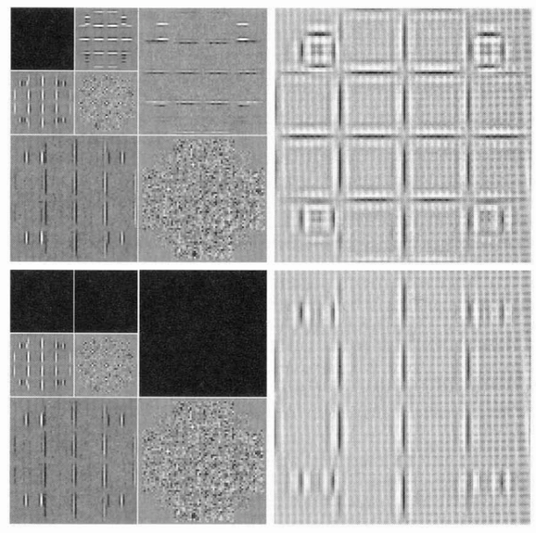
Applications of Wavelet Transform
Edge detection
Fig. 25 example of edge detection using Discrete Wavelet Transform[1]

Slide 78
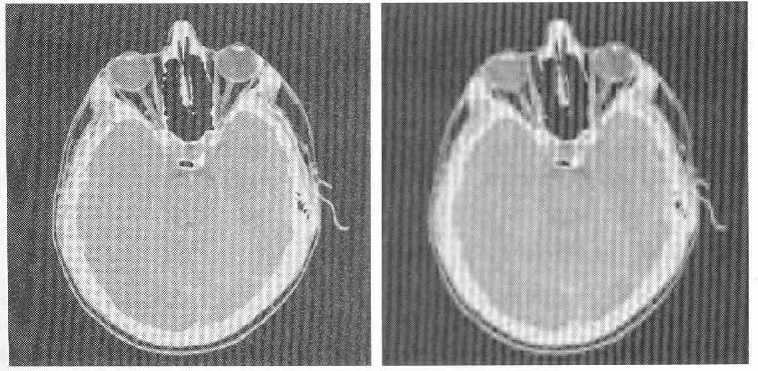
Applications of Wavelet Transform
Noise removal
Fig. 26 example of noise removal using Discrete Wavelet Transform[1]

Slide 79
Conclusion

Slide 80
Reference
R. C. Gonzalez and R. E. Woods, Digital Image Processing 2/E. Upper Saddle River, NJ: Prentice-Hall, 2002, pp. 349-404.
S. Mallat, Academic press - A Wavelet Tour of Signal Processing 2/E. San Diego, Ca: Academic Press, 1999, pp. 2-121.
J. J. Ding and N. C. Shen, “Sectioned Convolution for Discrete Wavelet Transform,” June, 2008.
Clecom Software Ltd., “Continuous Wavelet Transform,” available in http://www.clecom.co.uk/science/autosignal/help/Continuous_Wavelet_Transfor.htm.
W. J. Phillips, “Time-Scale Analysis,” available in http://www.engmath.dal.ca/courses/engm6610/notes/node4.html.

